Slide 1
MODULE I
ENVIRONMENT AND ECOSYSTEMS
LECTURE II

Slide 2
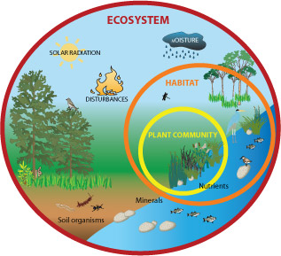
ECOSYSTEM
An ecosystem is a structural and functional unit of ecology where the living organisms interact with each other and the surrounding environment. It can be described as the community where the plants and animals live together.
An ecosystem is also referred to as the ecological system. The term Ecosystem was first coined by an English botanist A.G.Tansely in the year 1953.
Ecosystem varies greatly in size from a small pond to a large forest or a sea. Many ecologists regard the entire biosphere as a global ecosystem, as a composite of all local ecosystems on Earth.

Slide 3
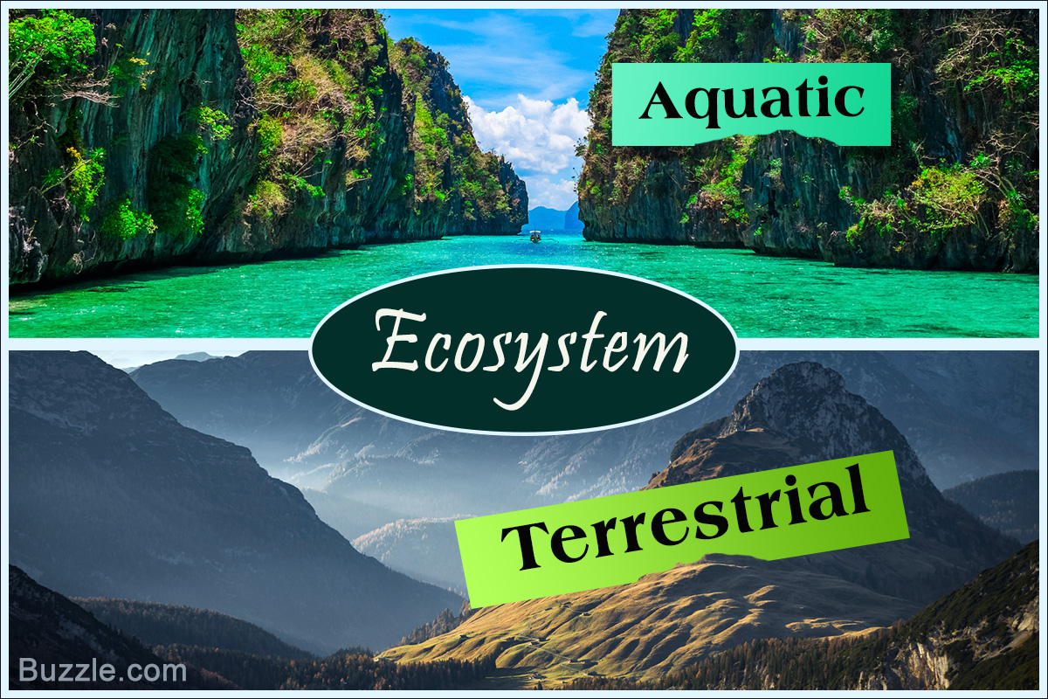
ECOSYSTEM
CLASSIFICATION OF ECOSYSTEM
it is convenient to divide it into two basic categories
Terrestrial : Forest, grassland and desert are some examples of terrestrial ecosystems
Aquatic: pond, lake, wetland, river and estuary are some examples of aquatic ecosystems.
Crop fields and an aquarium may also be considered as man-made ecosystems.

Slide 4
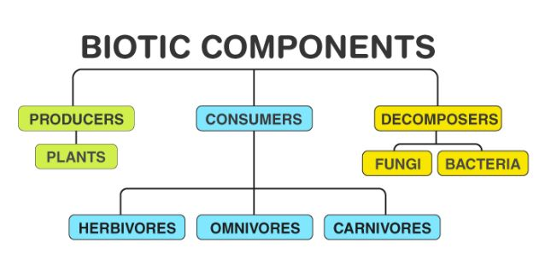
ECOSYSTEM - STRUCTURE
Structure of an Ecosystem:
The structure of an ecosystem is characterized by the organization of both biotic and abiotic components.
Biotic component:
The biotic components comprise of living organisms including the plants, animals, insects, reptiles, and even the microbes. The term Biotic refers to life.

Slide 5
ECOSYSTEM - STRUCTURE
Autotrophs And Heterotrophs
On the basis of nutrition, they can be autotrophs or heterotrophs.
The autotrophs include green plants that prepare their own food by utilising sunlight and energy by the process of photosynthesis.
The heterotrophs include all the animals that depend upon the autotrophs or other heterotrophs to fulfil their nutritional requirements.
On a wider scale, the biotic components can be further classified into:
a. Producers
All green plants are the example of producers. As they synthesise their own food through the biological process known as photo­synthesis.

Slide 6
ECOSYSTEM - STRUCTURE
b. Consumers
All animals including humans are examples of Consumers.
All consumers depend on plants for their food as they cannot synthesise their own food.
Classified into primary, secondary, tertiary and quaternary consumers.
Primary Consumers–
The primary consumers depend upon green plants for their food. For eg., deer, elephant, cow, goat, etc.
Secondary Consumers–
These feed on producers and primary consumers and include the carnivorous and omnivorous animals. For eg., wolves, fox, snake , owl , etc.

Slide 7
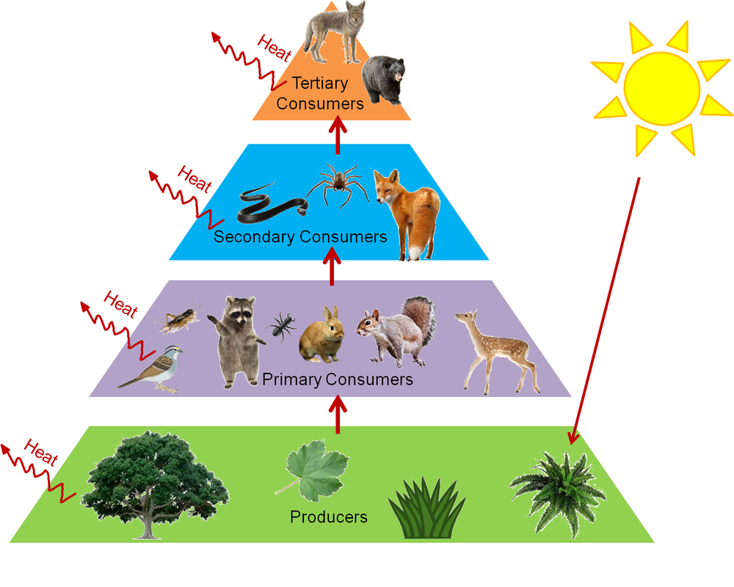
ECOSYSTEM - STRUCTURE
Tertiary Consumers
These include the top carnivorous animals including lion, tiger, vultures that feed on herbivores, carnivores, and omnivores.
Quaternary Consumers
These include the scavengers and parasites.
The scavengers feed on the dead remains of plants and animals whereas the parasites live in the body of the other animal and derive nutrition from its body.

Slide 8
ECOSYSTEM - STRUCTURE
Decomposers or Reducers
Bacteria and fungi are examples of Decomposers.
These help to maintain the structure of the ecosystem.
The decomposers are involved in breaking down the dead and organic materials of producers and consumers into simpler substances.
Abiotic components
The Abiotic components comprise of all the non-living factors or the physical environment prevailing in an ecosystem. The term Abiotic refers to without life. Wind, air, sunlight, soil, light, climates are all examples of Abiotic components.

Slide 9
ECOSYSTEM- FUNCTIONS
FUNCTIONS OF AN ECOSYSTEM
The functions of an ecosystem are mentioned below:
The main function of an ecosystem is to keep the components running together.
It is also involved in regulating all the essential ecological processes, supporting life systems and rendering the stability.
It is also responsible for the cycling of nutrients between biotic and abiotic components.
The producer, consumers and decomposers maintain the food chain and energy flow in the ecosystem.
The decomposers cycle the minerals through the biosphere.
The abiotic components help in the synthesis of organic components that involves the exchange of energy.

Slide 10
FOOD CHAIN
A food chain is a linear sequence of organisms through which nutrients and energy pass as one organism eats another i.e. each organism eats the smaller organism and eaten by larger organism. All those organism which are interlinked with each other through food constitutes a food chain.
Different species in a food chain are called trophic levels.
Each food chain has 3 main trophic levels.
They are producers, consumers, and decomposers, the energy flows in a specific pathway.
NB:- SPECIES: A group of living organisms consisting of similar individuals capable of exchanging genes or interbreeding

Slide 11
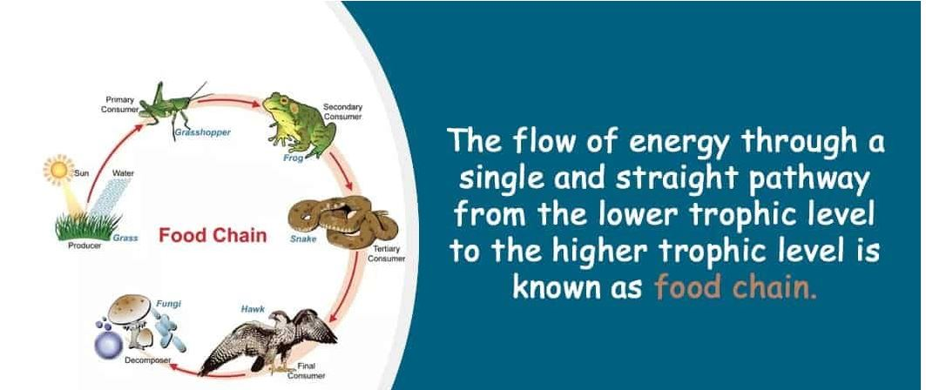
FOOD CHAIN

Slide 12
FOOD CHAIN
Each step of the food chain forms a tropic level.
The producers (green plants) are at the first tropic level.
Primary consumers (herbivores) are at the second tropic level.
Secondary consumers (small carnivores) constitute the third tropic level.
Tertiary consumers (larger carnivores) form the fourth tropic level.
Producers have the greatest number of individuals
DECOMPOSERS
TERTIARY CONSUMERS
SECONDARY CONSUMERS
PRIMARY CONSUMERS
PRODUCERS

Slide 13
FOOD CHAIN
The autotrophs capture 1% of energy present in sunlight and convert it into chemical energy, the chemical energy then flows to heterotrophs and decomposers.
When green plants are consumed by the primary consumers a great amount of energy is lost as heat to the environment and rest of the energy is used up by the body of consumers for digestion, growth, reproduction.
An average of 10% of food is turned into its own body which is again consumed by the secondary consumers.
At the fourth tropic level very less mount of usable energy remains as the energy which flows from one level to another is very little.
Chemicals may enter our bodies through food chains.

Slide 14
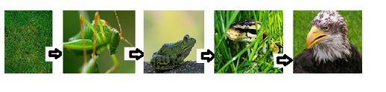
FOOD CHAIN
EXAMPLES
1. Grass insects frog snake eagle
Grass is eaten by insects and frogs eat the insects which in turn are eaten by the snakes and eagles eat the snakes.

Slide 15
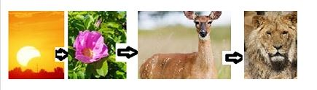
FOOD CHAIN
2.Sun plant dear lion
Flow of energy takes place from one component of the food chain to another.

Slide 16
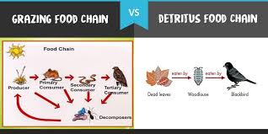
FOOD CHAIN

Slide 17
FOOD WEB
Food web is an important conceptual tool for illustrating the feeding relationships among species within a community.
It reveals about species interactions, community structure, and understanding the dynamics of energy transfer in an ecosystem.
Various food chains are often interlinked at different trophic levels to form a complex interaction between different species from the point of view of food .This network interaction is called food web.
If any of the intermediate stage of food-chain is removed ,the succeeding links of the food chain will be affected.

Slide 18
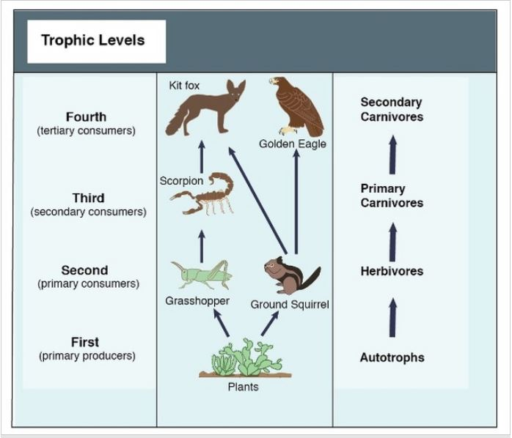
FOOD WEB

Slide 19
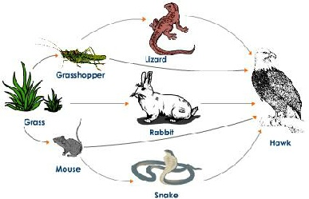
FOOD WEB

